Slide 1

Getting Started with Visual Studio
Mobile Center
Michael John T. Peña
Microsoft MVP

Slide 2

Microsoft MVP – Windows Development
CTO @gluonconsulting
Xamarin Enthusiast
Wine Lover
Friend ni Jon Limjap at Allan Mangune

Slide 3
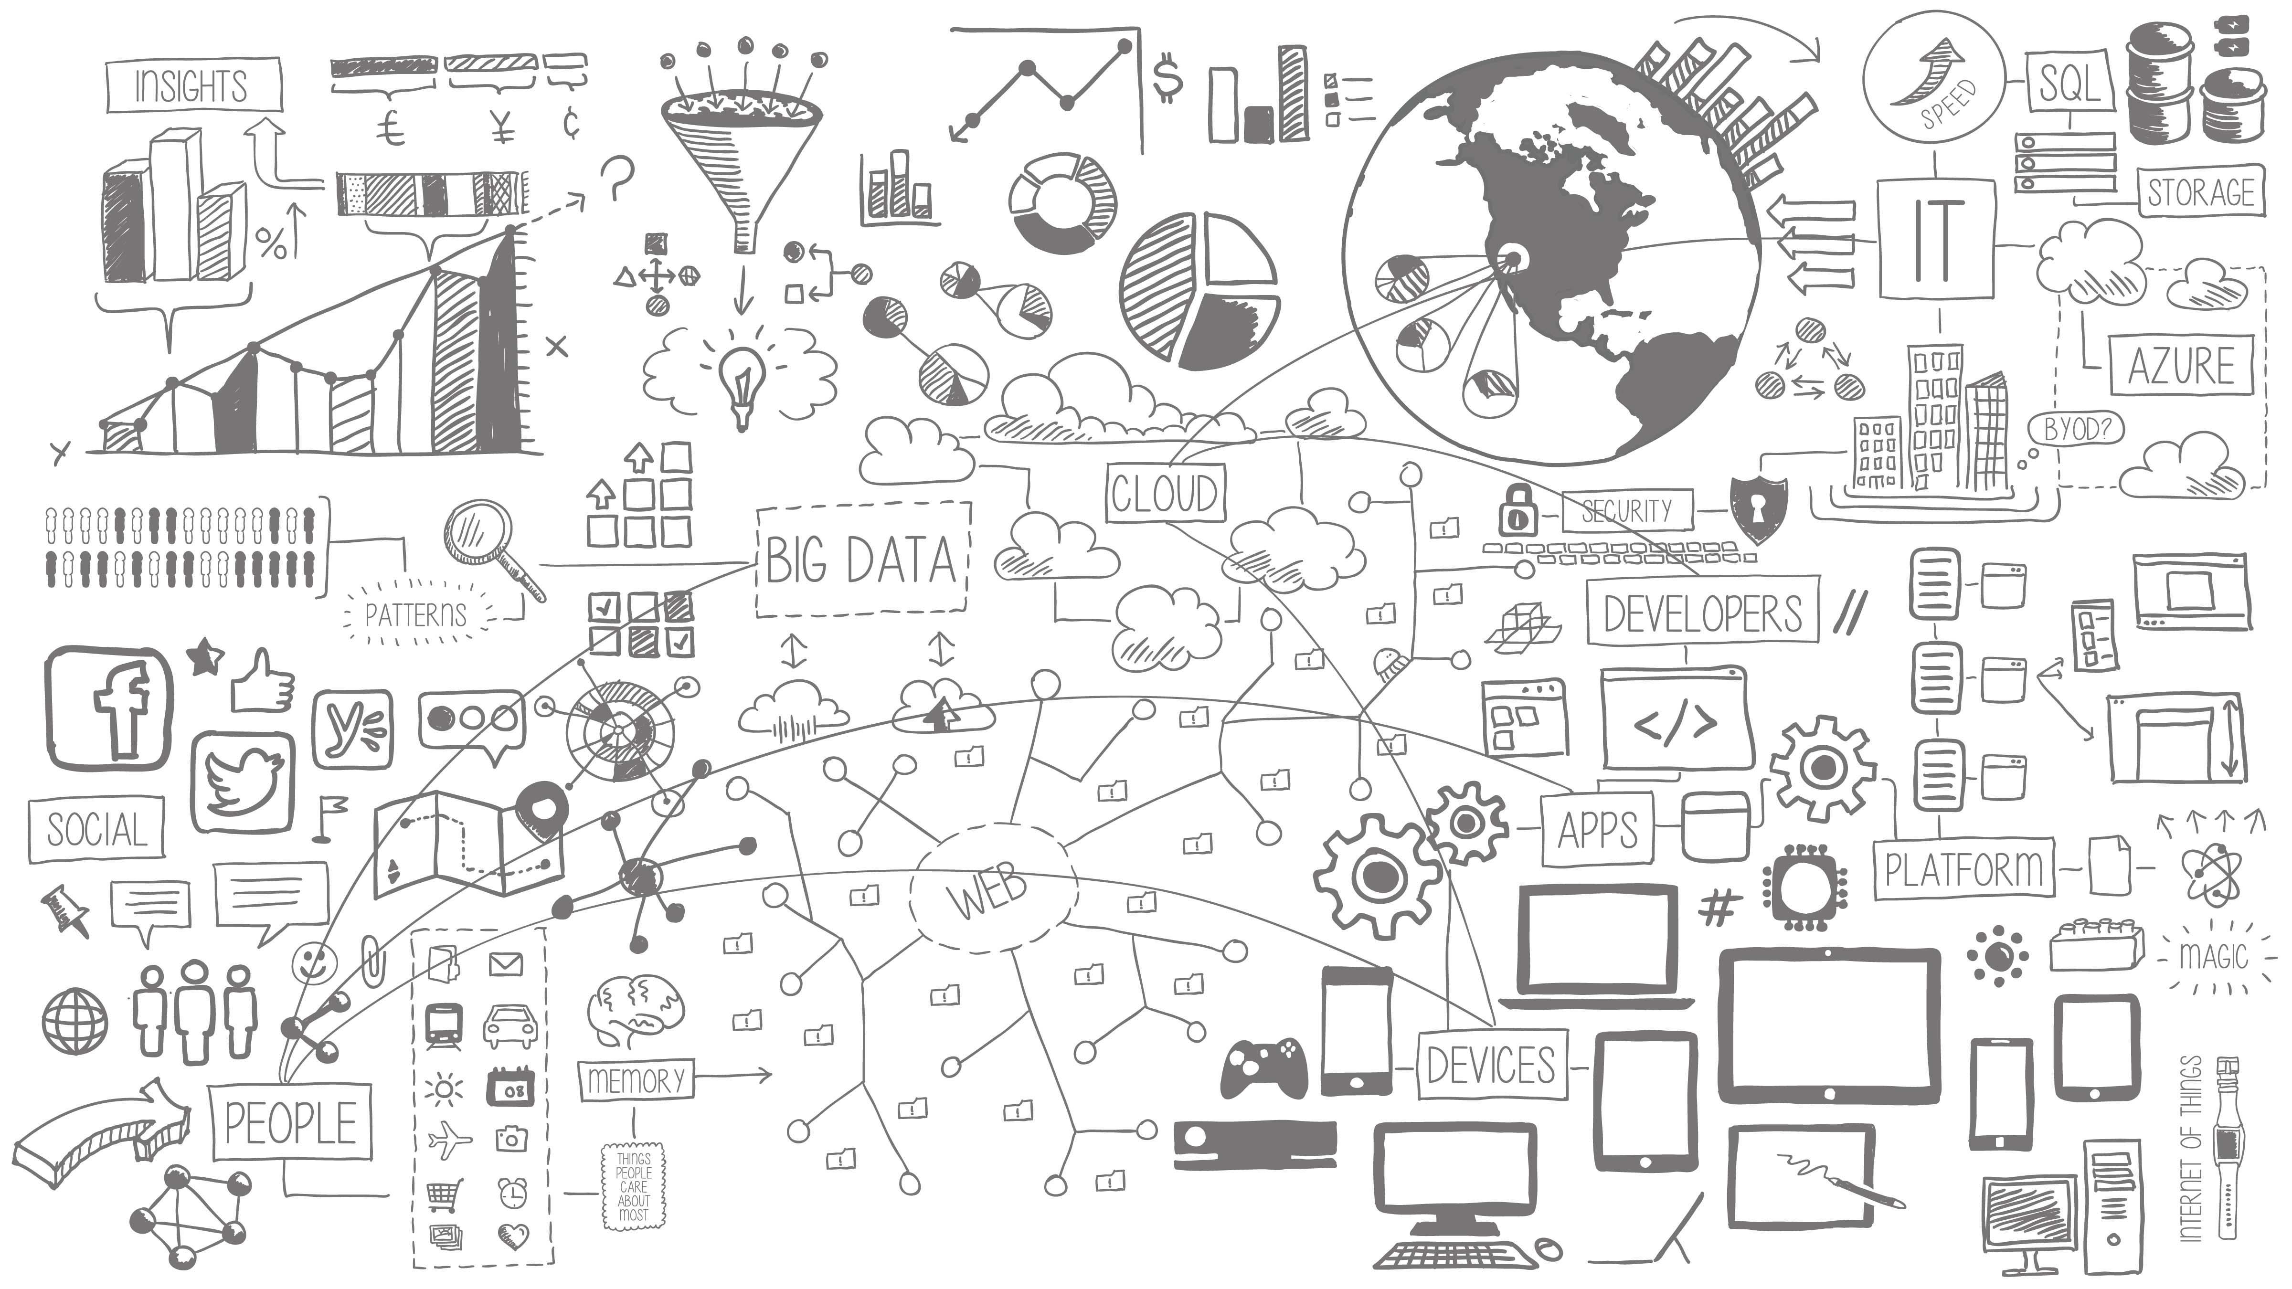
Mobile is transforming how we live and work …
Mobile represents the single largest technology innovation of all time.
Notes:
Mobile devices are now at the center of the technology ecosystem
Users cannot live without their mobile devices and organize their lives and information with them
Employees bring them to the workplace and depend on them to get things done

Slide 4
Mobile has happened ...
Faster than the PC boom of the 80s
10x
3x
Faster than the recent social networking explosion
Faster than the Internet boom of the 90s
2x
Notes:
In fact, the mobile revolution is not “coming” or “under way”, it has already happened!
And the mobile tidal wave proved to be faster and bigger than anything that came before it
¹ http://blog.flurry.com/bid/88867/iOS-and-Android-Adoption-Explodes-Internationally
² https://intelligence.businessinsider.com/smartphones-outpacing-pcs-two-to-one-2012-11
³ http://www.slideshare.net/kleinerperkins/kpcb-internet-trends-2013

Slide 5
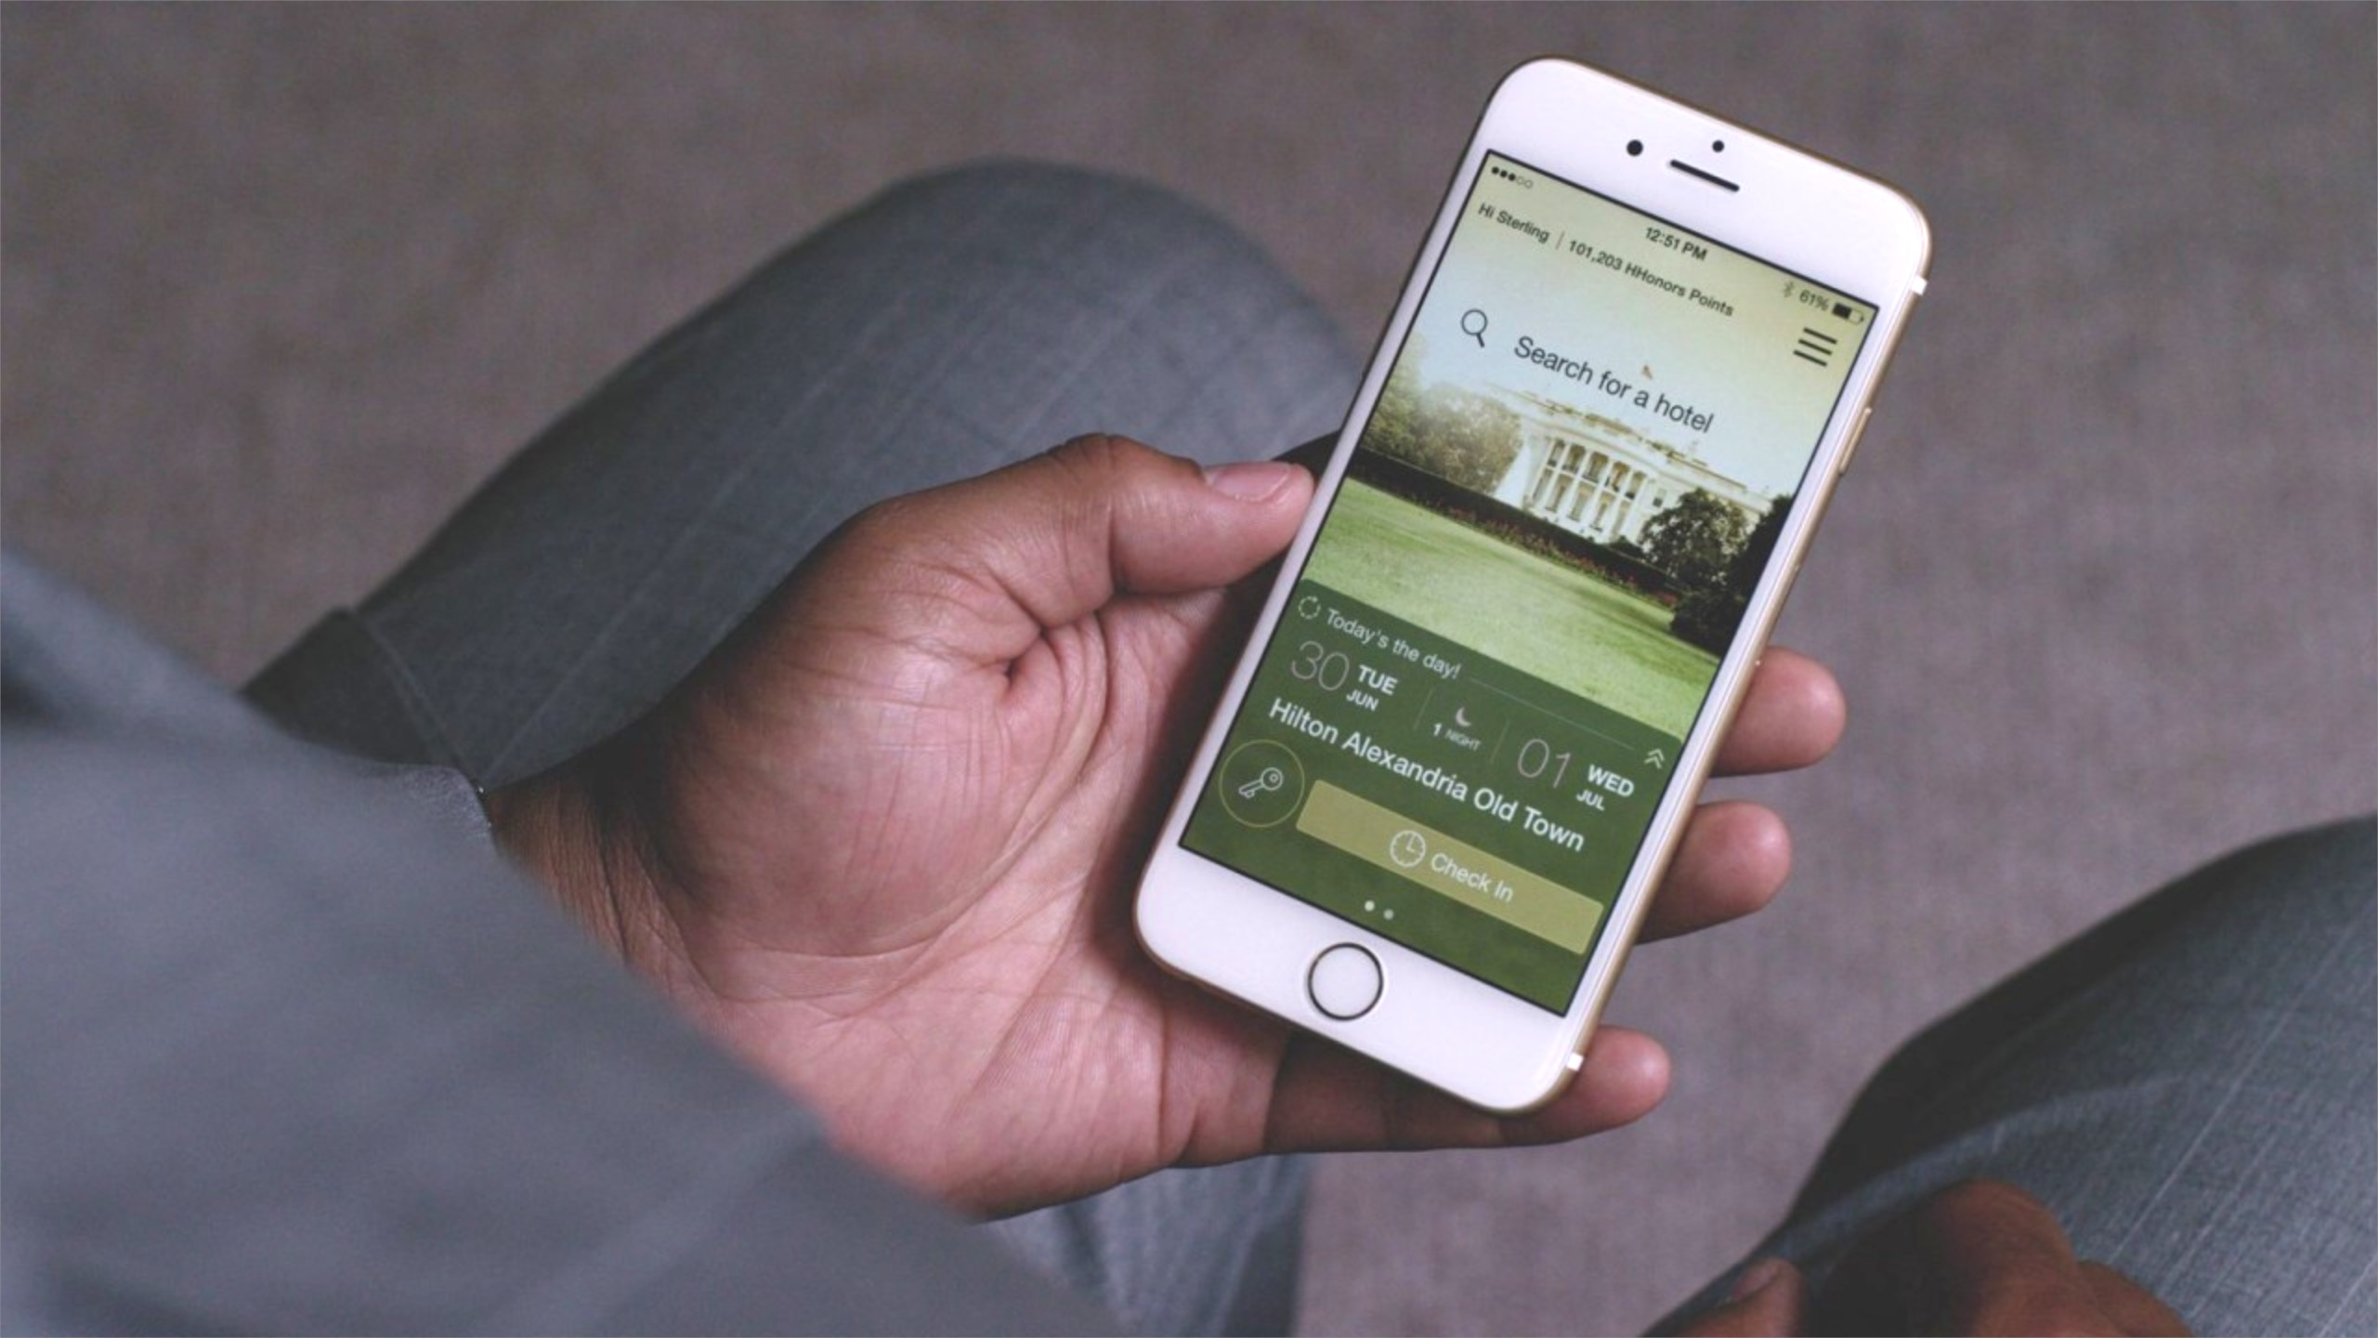

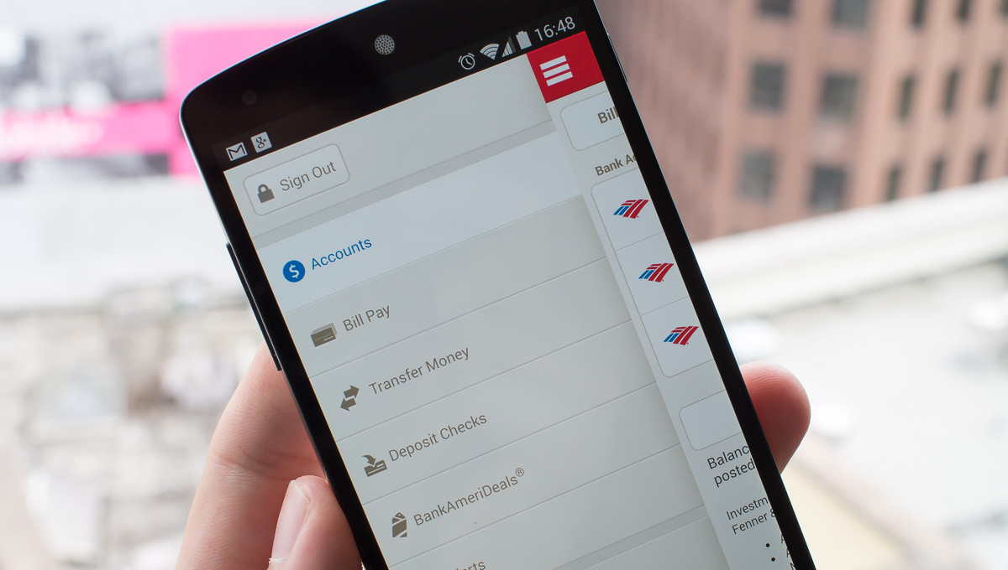
Every business is a mobile business
Entrepreneurs
Enterprises
Notes:
Every business today is also a mobile business – and it‘s really just common sense: if users and customers go mobile, business will follow
But there are marked differences in how individual organizations tackle mobile
Mobile entrepreneurs disrupt the status quo in their field with a mobile-first strategy and revolutionary mobile apps
In many cases, they can start from scratch and focus fully on their vision without being bogged down by legacy systems or processes
Mobile entrepreneurs relentlessly experiment, unencumbered by history
Companies like Uber set the standard for how an app should function
Enterprises face a very different challenge – they are already well established in their industries and look for a way to extend their existing business to mobile
Rather than starting with a blank slate as entrepreneurs do, enterprises need to take into account existing infrastructure, systems and processes and find the best way to adapt those to the fast-paced mobile world
Enterprise success is really about mobilizing backend systems and data to increase revenue, decrease costs, and improve productivity
To do this they have to be thoughtful in their mobile approach across the enterprise:
They have to consider things like integration with backend systems – and whether those systems should remain on premises or move to the cloud
They have to consider their users – customers and partners as well as employees - who are expecting a great user experience and want to bring their own devices
They have to consider security and management in an environment where they have less control over user devices and access points
They have to take into account existing skills and processes so they can get the most out of prior investments and people

Slide 6
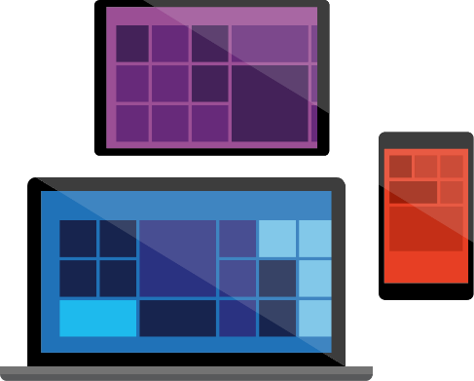
Mobile apps are a part of larger modern applications
More than just apps …
A mobile app strategy is not sufficient if you want to be successful in your future mobile development efforts. You need to think of mobile apps as one component of larger, modern, omnichannel application architecture …
*Source: Forrester Predictions 2015: CIOs Accelerate The Business Technology, Q4 2014
Notes:
How can enterprises respond to the mobile phenomenon and understand what to keep and what to change in their current approach to business?
Putting an isolated, one-off mobile app out there is not enough to be successful
Forrester Research defines mobile apps as one aspect of a much bigger, omnichannel business strategy
This means that businesses need to think about more than just the mobile app, they need to take a holistic approach when it comes to their business application ecosystem
They need to find the best way to extend their existing business to mobile which means embarking on a quest of broader infrastructure modernization that includes all application and infrastructure layers, starting with the mobile client and app backend – but also review the processes that are in place for building, testing and delivering complex, interconnected multi-channel business applications

Slide 7
The appification of modern business
There’s an app for that …
Consumer apps are everywhere. Now, the same thing is happening across every aspect of the modern business.
In order to be successful and stay valuable to their users – customers, employees and partners – businesses will have to support a multi-app mobile strategy and provide dedicated apps for different purposes and user groups.
Notes:
Many businesses have already started their journey to mobile with consumer apps some time ago, so they are familiar with some of the biggest challenges
When the iPhone came out there was “an app for that”
And now the same thing is happening across every aspect of the modern business
Businesses are realizing that in order to be successful and thrive they will have to support not just one mobile app but a multi-app mobile strategy
We call this the appification of modern business – the proliferation of targeted, highly optimized apps designed for a particular group of users or specific task or purpose
But what does an appified business look like - and how can this state be achieved in a quick and efficient manner?
Especially if your core competency is not software development, this can seem daunting
In fact, this is one of the most common challenges enterprises are facing - how to deliver apps at scale

Slide 8
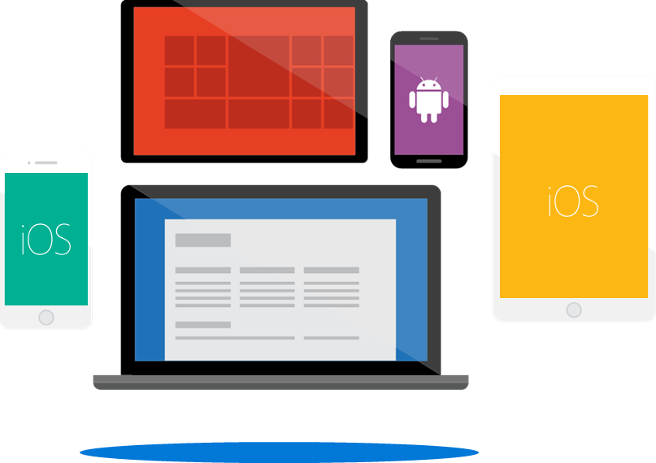
Enterprises are going mobile on multiple platforms
In 2016 …
Employees use an average of 3 different devices in their daily routine today, and this will increase to 5 or 6 devices as new technologies like IoT and wearables become more mainstream.
*Source: Gartner (http://www.gartner.com/newsroom/id/3076817)
Notes:
Another challenge that often emerges is the complexity and fragmentation of the mobile ecosystem
In 2016, 90% of enterprises will have two or more device platforms to support
The average number of platforms targeted by a mobile developer is 2.9
Many enterprises are struggling to keep up with mobile growth
The appetite for mobile apps far exceeds their ability/capacity to deliver said apps
Gartner estimates that through 2017, the market demand for mobile app development services will grow at least five times faster than internal IT organizations’ capacity to deliver
If you want to thrive in this appified business world, you have to do two things: look holistically at your mobile strategy across all aspects of your business and find ways to scale delivery

Slide 9

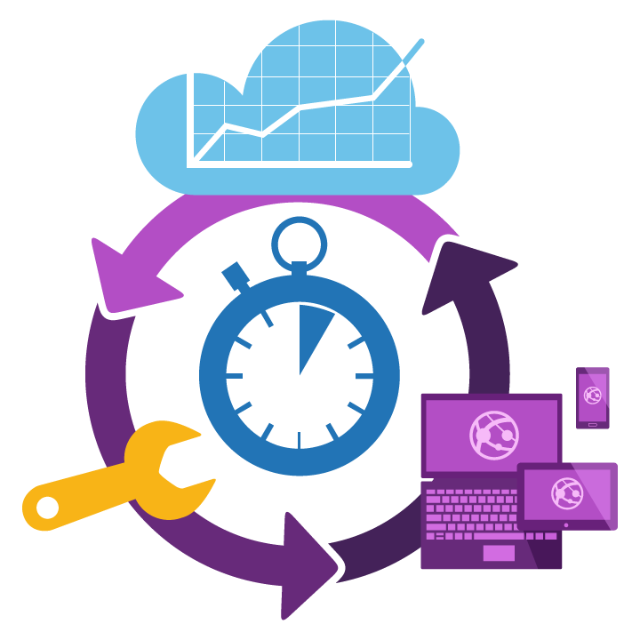



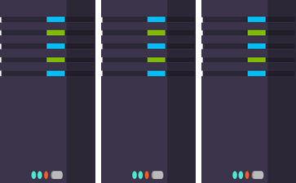
How Microsoft can help
Enterprise Cloud Platform
Create rich, cross-platform
mobile experiences
Deliver mobile applications with digital-era agility + velocity
Extend business data and LOB applications to mobile
Notes:
No matter how far you have progressed on the journey to an appified business and which aspect of the mobile business transformation you want to tackle, Microsoft can help
We enable organizations of any size deliver state-of-the-art mobile experiences across any device (Android, iOS, and Windows) in a way that maximizes development productivity and adapts to your and your organization’s needs and skills
Our solution supports a flexible set of mobile development options from multi-device native applications to mobile web and hybrid apps
Our enterprise cloud platform provides powerful and flexible cloud services that make it easy to securely extend existing infrastructure assets and data to mobile
Our solution is technology-agnostic – whether it’s .NET, Linux, native iOS or Android – our tools and services are cross-platform, open and flexible
Together with the Microsoft cloud platform and our integrated DevOps tooling, Microsoft has created a comprehensive solution for modern enterprises to plan, build, test, deploy, operate, and monitor mobile business-to-business as well as business-to-consumer applications across all application and infrastructure tiers

Slide 10
Modern application architecture
The mobile client
Notes:
Let’s take a closer look at the different aspects of a successful mobile app strategy
We’ll begin with the piece that users and customers engage with and which should be considered as an extension of your company’s storefront: the mobile client

Slide 11

Mobile-first, Cloud-first
Put people at the center
Devices and device sizes come and go, within a single year, you will be using multiple phones. It's more about mobility. In fact, if there's anything that is central to our vision, it's ‘don't think of the device as the center, think of the individual, the person as the center’.
Satya Nadella, Microsoft CEO
Notes:
You might have heard Microsoft’s new mantra Mobile-first and Cloud-first before – Microsoft is a mobile-first, cloud-first company
Satya Nadella explained what this means in his first email to all Microsoft employees back when he took over as CEO
Mobile-first means that we have to think about users first, both individuals and organizations, and target the devices they use every day
Mobile-first apps will come with you and serve you wherever you are at a given moment in time, on any device
No longer can we target just a single platform or form factor, apps need to go where users go
So, in fact, every app needs to be mobile – it needs to adapt to different user contexts
This means that a mobile app is not just an app that runs on a phone or a tablet – it’s an app that runs across all from factors, from desktops with gigantic screens to watches with tiny screens and limited power IoT or embedded devices
Cloud-first means that all these apps that run everywhere are just a window into the much larger functionality that resides in the app backend
Every app needs a backend
And if you are looking to provide a 24x7 reliable, scalable service backend that is also cost-efficient to run and maintain, then you will quickly realize that this is actually very difficult and expensive to do all by yourself
But the cloud enables anyone to spin up and run backend infrastructure in minutes, with minimal capital outlay
Exponential growth across connected users, connected devices and mobile-first applications is what is driving the growth in cloud that we see today

Slide 12
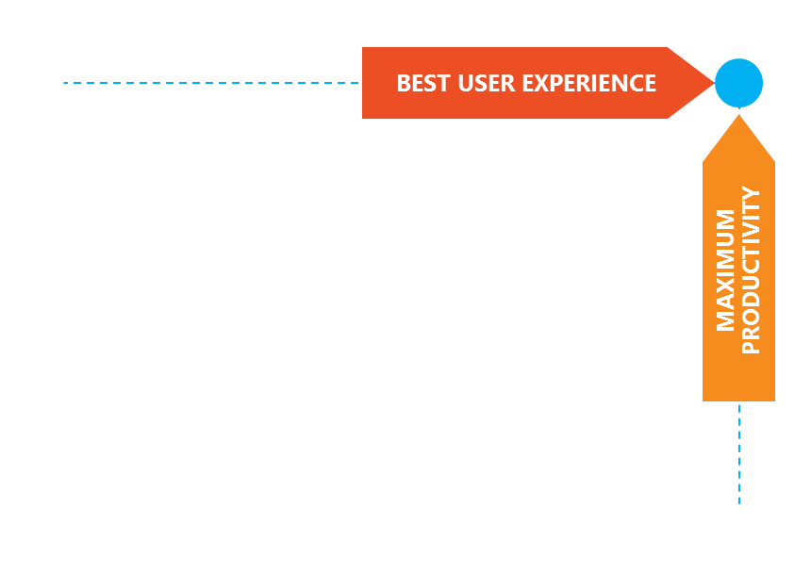
The mobile app dilemma
trade-off
noun
noun: tradeoff
A balance achieved between two desirable but incompatible features; a compromise. "a trade-off between objectivity and relevance"
Notes:
Building a mobile client application almost always involves a tradeoff decision right at the beginning of the project
You can optimize your app for the best user experience – and provide a great, polished, native UI that excites and delights users, all the time
However, achieving this goal requires a lot of expertise and effort – for each platform you target, you need to learn different languages, understand individual UX metaphors and apply them consistently, design great user interfaces and keep your eyes on the rest of the market to make sure your app is the latest and greatest since the competition might have come up with something in the meantime that has changed the definition of what makes a mobile app great
Additionally, each platform forces you to learn and master different developer tools and practices
If you are trageting multiple platforms, sharing code and logic across platforms is very difficult, and there is a high risk of duplicate work because you will need to maintain multiple codebases and keep them in sync
The tradeoff is between best user experience and maximum productivity
The technology choice you make at the beginning of the project optimizes either one or the other

Slide 13
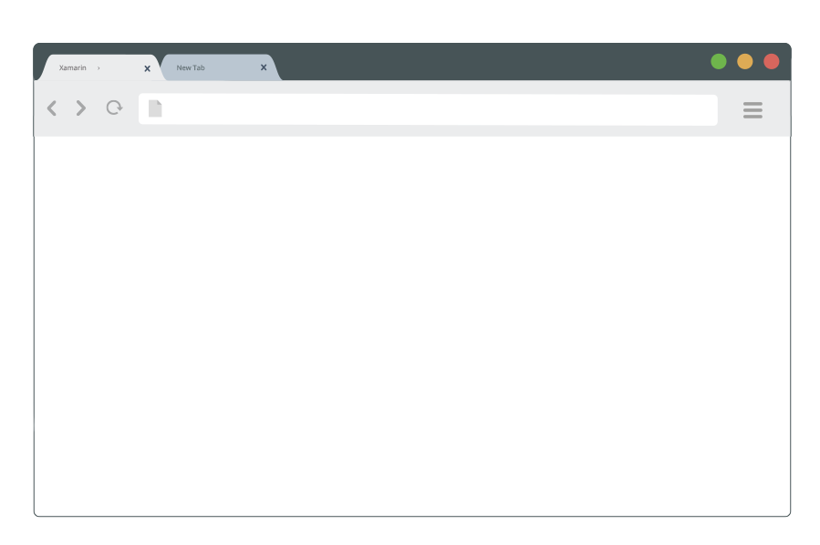
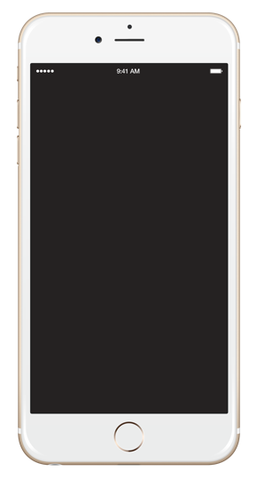
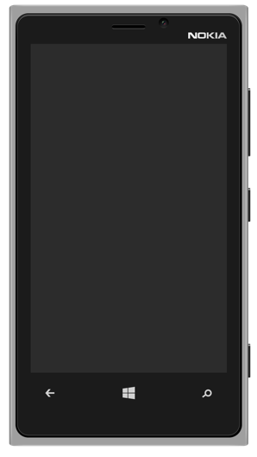
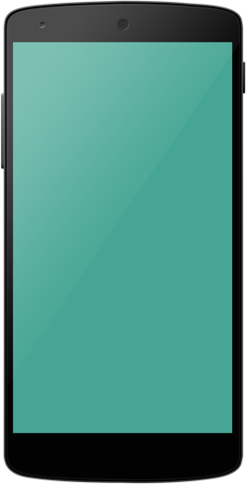


Mobile approaches
Hybrid and Web
Platform Silos
Cross-Platform Native
HTML 5
JavaScript/TypeScript
Obj C
C#
Java
Shared Code
User Experience
Non-native UX Performance compromises | Native experience Maximum performance | Fully native UI and performance High fidelity API access
Build once, iterate easily | Multiple code bases Higher TCO and maintenance | Only one code base, one team
Mature tooling, variety of tools | Little or no lifecycle management tool support from platform vendors | Full-featured end-to-end lifecycle management and DevOps tools
Developer Productivity
Tools
Notes:
Here is an overview of the three most common mobile approaches and their major benefits
Which approach is best for your project depends on many internal and external factors - team skills, existing or legacy code, complexity of specific developer tools – all of these aspects (and more) play a role in the decision-making process
And if you are looking to target multiple platforms with your app, a completely new level of complexity is introduced – how do you make sure that you do not duplicate effort needlessly or double or triple the number of codebases you will need to maintain? Will you have multiple teams for multiple platforms? How do you make sure apps are in sync with regards to features, versioning and in-flight releases?
All of these questions can become potential issues and lead to project failure down the road so it is a good idea to have a plan from the beginning rather than rebooting your project in the middle

Slide 14
Platform silos
Objective-C + Xcode
Java + Eclipse
.NET + Visual Studio
End User
Platform-native UX
Full performance
Native service integration
End user experience
Better TCO, productivity and development experience
Developer
Only services (server-side) can be re-used
Client development and developer experience is different for each platform and device type
Higher TCO due to multiple code bases and requirements for developer skills
Notes:
One option is the silo’ed approach – today, it is very common to see a company or developer create the same app multiple times in different languages with different tools for different platforms
While this might give you a fully native user experience and maximum performance, it is also expensive, can require multiple teams and generally takes more time
But the biggest issue of this approach is the future maintenance overhead of managing and maintaining apps and code for multiple different platforms

Slide 15
Platform silos
Native applications (x3)
Individual native apps built for each platform
Native user experience but lowest code re-use
Only services (server-side) can be re-used, with custom code required for consuming
Client development and developer experience is different for each platform and device type
Higher TCO due to multiple code bases and developer knowledge
Native UI
XIB
Native UI
AXML
Native UI
XAML
Native code
ObjectiveC
Native code
Java
Native code
C#, JS, C++
XCode
Eclipse
Visual Studio

Slide 16

Write once, run anywhere
End User
Non-native UX
Performance tradeoff
Works across devices
End user experience
Better TCO, productivity and development experience
Developer
Great for teams with HTML/JavaScript skills
Scaling to enterprise complexity challenging
Developer productivity with Visual Studio
Mature tooling
Notes:
Modern web technologies provide an abstraction layer between the environment an app is running in and the application itself
This means, that web apps and web sites can be built once and run anywhere, on any platform if they are designed to take into account the specific idiosyncrasies of different browsers and JavaScript execution engines
In recent years, web technologies have sufficiently matured that this promise is actually being fulfilled today
However, creating truly native experiences that are indistinguishable from native apps is still very difficult – or even impossible - to achieve
There are two types of web applications:
A responsive web application is developed using HTML5, CSS3, and JavaScript and can be viewed on phone/tablet browsers and optionally be installed locally for offline use
To support a variety of device sizes while keeping a single code base, a web app should use responsive web technologies like CSS3 or frameworks like Bootstrap or Foundation
A hybrid mobile app is built using HTML5, CSS3, JavaScript and a wrapper like Apache Cordova that provides access to device features like camera or geolocation
Hybrid apps can run on iOS, Android, Windows Phone and Black Berry
A hybrid app is 'hybrid' because it uses HTML 5 & CSS3 for the mobile UI and JavaScript for the app logic and to communicate with the native device SDK
A hybrid app is a single page application (SPA) - basically a web application that lives within a single HTML page

Slide 17
Write once, run anywhere
Code/UI Wrapper
Hybrid applications
Presentation layer written in HTML/CSS and logic written in JavaScript/TypeScript
Highest code reuse ratio but non-native UX
Overall performance depends on container and platform technology/UI frameworks
Web applications
Browser-based web apps and mobile sites
Cross-platform: write once, run everywhere
Best updateability but non-native UX
CSS, HTML, JavaScript, TypeScript, Ionic

Slide 18

Cross-platform native with Xamarin
“The best of both worlds”
C#
End User
Platform-native UX
Full performance
Native platform service integration
End user experience
Better TCO, productivity and development experience
Developer
100% C# with 100% of platform APIs exposed
More productivity and faster development
Up to 95% code reuse across platforms
Up to 100% shared UI with Xamarin.Forms
One code base & IDE for client and backend
Notes:
Mobile is transformative because mobile apps are context-aware – and context-aware apps require full access to native device capabilities
Mobile users - consumers and employees alike - are more likely to abandon apps that show poor performance or non-standard UI, navigation and controls because it slows them down and forces them to re-learn things they already know
Xamarin takes .NET to the next level and extends it to iOS and Android
Xamarin apps are 100% C# and 100% of Android + iOS platform APIs are exposed
With Xamarin, everything you can do with Objective-C or Java, you can do with .NET
Xamarin apps are 100% native apps, indistinguishable from platform-native apps created with Android Studio, Eclipse or Xcode
Xamarin also includes powerful iOS and Android UI designers that enable you to create beautiful user experiences for Windows, iOS and Android in a visual designer with drag-and-drop simplicity
Xamarin enables developers to use the same languages, libraries, and tools for all major mobile platforms, unlocking the extraordinary productivity of .NET for any iOS and Android while using existing skills and enabling effortless sharing of code among platforms
With Xamarin, you can build native apps once and run them everywhere – giving developers the most productive and powerful platform for creating native cross-platform applications
The cross-platform native approach combines the benefits of both worlds - you get the native user experience for each individual platform, and you also eliminate rework and increase organizational innovation and responsiveness by delivering more apps faster

Slide 19
Cross-platform native
Cross-platform native UI with Xamarin.Forms
Anything you can do in Objective-C, Swift or Java, you can do with Xamarin
Native user interface
Native performance
High-fidelity API access
Shared app logic in C#
Native UI
Native UI
Native UI
C# + XIB
C# + AXML
C# + XAML
Platform-specific low-level APIs

Slide 20
Summary: mobile client approaches
“The best of both worlds”
Platform silos
C#
Cross-platform native
End user experience
Hybrid
Better TCO, productivity and development experience
Notes:
You have seen the different options – now all you need to do is select the strategy that best fits your needs – it’s easy, right ☺
No matter which approach you take, Microsoft supports your choice
Develop multi-device apps that are native, browser-based, or hybrid, and use your existing skills and knowledge of .NET or HTML and JavaScript development
Our tools and services are tailored to the needs of your application, building on your skills and enable you to create and deliver amazing mobile experiences for Android, iOS or Windows without sacrificing productivity or slowing time to market

Slide 21
One platform for client and backend
.NET FRAMEWORK
Multi-purpose, comprehensive framework for desktop, web and mobile applications
Modern DEVICE EXPERIENCES
Universal Windows platform
Unified development across Windows devices
XAMARIN
Extend your reach to any device with .NET
Modern CLOUD & web EXPERIENCES
.NET CORE
Cross-platform, high performance .NET
ASP.NET Core
Cloud-optimized web framework for micro services
Innovative | Cross-platform | Open
Notes:
One huge benefit of .NET is that you can use one platform for both the mobile client and backend!
This means only on set of tools, one set of skills and one codebase for your entire solution which saves huge amounts of time, effort and lowers complexity

Slide 22
Modern development practices
Agile and DevOps
Notes:
We have talked about frontend and backend, client and service – the what of we are building
Let’s now take a step back and examine the how – how to build and deliver successful mobile applications
In the first decade of Agile, development teams have become extremely efficient at developing software faster through agile practices
What we also saw in the first decade of Agile were two distinct lifecycles: application development and operations
As we move into the second decade of Agile, we are seeing a convergence of these two lifecycles into a single unified lifecycle called DevOps
In the mobile app space – even more than for other application types - Agile and DevOps are absolutely central for success
Rapid implementation and continuous iteration are the new normal in mobile app development

Slide 23
The converged DevOps lifecycle
Plan + Track
Release
Development
Production
Develop + Test
Monitor + Learn
Notes:
How is it that some companies like Netflix, Amazon, Etsy, and Facebook regularly deliver new features and innovation to their customers while other companies must wait weeks or months to release software updates?
Today, we see continual frustration in all phases of the software development lifecycle:
Business, customers and IT all suffer from a lack of collaboration and communication between development and operations in software projects
This increases time and labor involved in delivering and maintaining software – not a good thing in a world where fast time to market is key
Add to that the problem that much of what we build is based on assumptions instead of hard data and you can see how this could easily lead a team to build the wrong thing
The inability to deliver software efficiently and react quickly to changes can lead to much more than just frustration – in the long run, this can threaten an entire business!
DevOps is not new – and it promises to solve these problems
What we see - especially in larger organizations – are two distinct lifecycles existing side-by-side: development and IT operations, with clear demarcations and barriers between them
For Microsoft - the world’s largest software company - DevOps has always been about unifying those two worlds
A converged DevOps lifecycle gives you the ability to execute on ideas quickly, iterate on feedback rapidly, with minimum friction while at the same time maintaining the highest levels of quality

Slide 24


Digital-era velocity
Notes:
Here is an example how a groundbreaking mobile application coupled with digital-era development practices has successfully enabled a new way of doing business in an established industry
The taxi industry has been disrupted by an innovator that relies on software to do things differently
What’s more, this mobile entrepreneur’s success is almost entirely attributable to their mobile app which made their unique business idea possible - without their mobile app, Uber would not exist
For Uber, being successful in the transportation market - first of all - meant short time to market
They successfully exploited the first-mover advantage by releasing their app very quickly
After that, rapid implementation and continuous iteration helped them solidify their lead over their competition by adding more value over time and adjusting their app based on user and customer behavior and feedback
Digital-era velocity in software delivery – the ability to deliver high-value applications quickly, without sacrificing quality - is a crucial competitive advantage for any business, and agile development and DevOps practices stand at the center of success

Slide 25
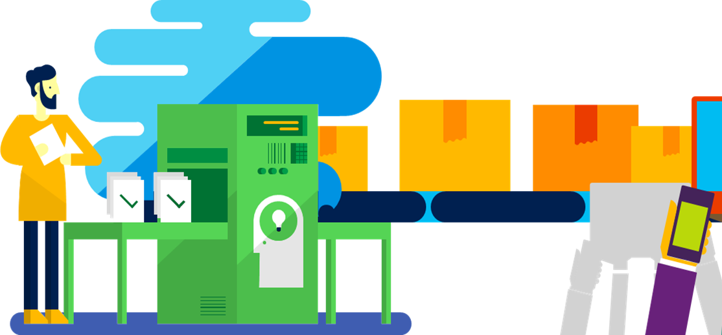
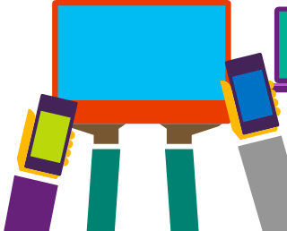
App factory mindset
Highest quality, lowest cost, shortest time to market
Maximize output and shrink lead times for new apps and updates.
Ensure highest-quality user experience on any device.
Scale delivery by standardizing work, automating processes, and minimizing redundancy + waste.
Notes:
Whether you are building your first mobile business app or whether your business is already appified - in order to achieve scale, you need to build an app factory mindset:
You have to be prepared to build not one app but many
You need a plan for scaling up to meet business demand
You need to optimize for maximum output and shortest lead times
You need have to have a plan for quality assurance - your customers, suppliers, and employees want the best experience, on any device
You need accelerators - pre-built integrations and service providers who can help you get started quickly and support you at inflection points along the way

Slide 26


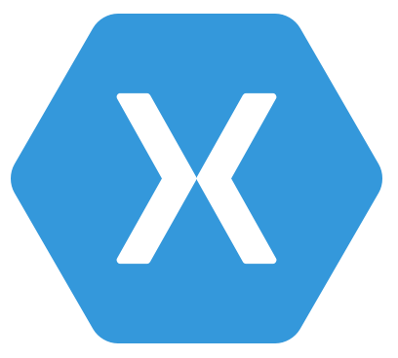
Mobile app continuous delivery
Code Repository
Build + Deploy
App Testing
Beta Testing
Backlog
Telemetry Collection
Users and customers install and use app
Monitor and improve
Notes:
Every project starts with an idea - and a plan how to turn this idea into reality – a new product or app feature
Developers track and manage work in a dynamic backlog that is constantly updated
Once an iteration starts, developers turn great ideas into features
For this, they need shared services – for example source control - that enable them to collaborate as a team, write and test code and build functionality
Whenever a developer checks in new code to the source control repository, a build is automatically triggered and after each successful build, automated integration and build verification tests run
After the build has been successfully verified, it is automatically deployed to pre-production environments and app testing commences – manual or automated UI testing on different devices, form factors and platforms
The next step involves user beta testing – selected users and groups get access to the app, install and use it on their devices and provide valuable feedback that the development team reviews and actions
Once a pre-defined quality bar has been reached, the app is deployed to the respective app stores and users and customers can install and use this app or update to the newest version
Once installed, the app collects telemetry data and performance and usage are monitored so that the development team can learn from real user interaction and evolve and improve the app in the next iteration – discovered bugs and issues flow directly into the project backlog where they can be triaged and actioned appropriately
Crash analytics helps developers identify app issues or bugs and enables fast root cause analysis to push out a fix or app update quickly

Slide 27
Challenge: Build and deploy faster
Business objective #1: Shorter time to market
Digital-era velocity challenges organizations to get new apps and features out faster than their competitors to achieve business success.
Business objective #2: Shipping app updates faster
High performing organizations have continuous delivery practices in place that enable them to recover from app issues in less than an hour.

Slide 28
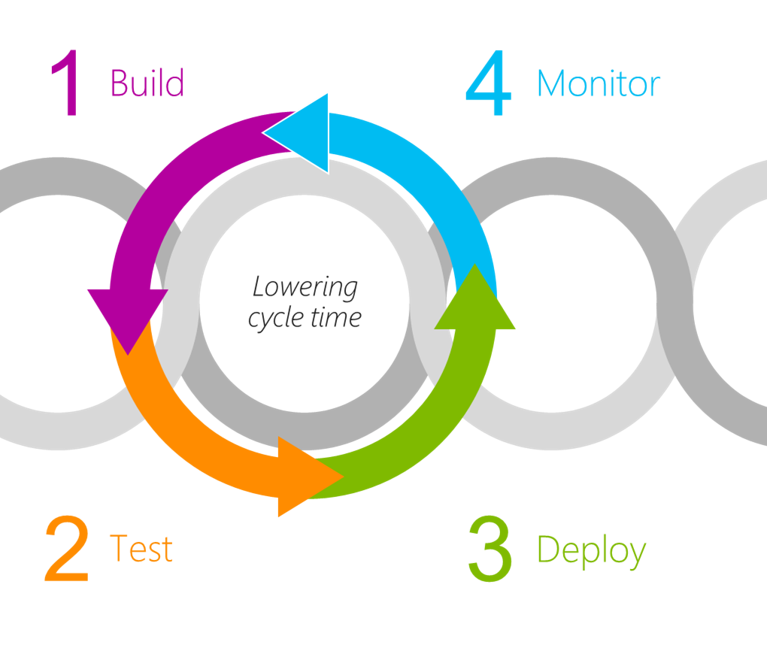
Solution: Continuous delivery
Continuous Integration
Mobile-era velocity requires build processes that automatically compile and test your application in the cloud or on premises, either on demand or as part of a continuous integration strategy.
Continuous Delivery
The next step is to fully automate deployment in repeatable, reliable ways while tracking simultaneous in-flight releases all the way to production.
Continuous Quality
Test changes continuously in a fast, scalable, and efficient manner and automate as much as possible.

Slide 29
Challenge: Mobile app testing & QA
Business objective #3: Reaching users across a broad range of devices and platforms
The mobile market is fragmented – many different screen sizes, form factors and OS versions make it difficult to create great app experiences for every user on every device.
Business objective #4: Make a great impression, always
Buggy apps don’t survive in crowded app stores, where reviews matter and your competitors’ apps are just a swipe away.
Notes:
Building high-quality apps is hard – but users expect the best experience everywhere and do not tolerate bugs
Each platform has different presentation styles, interaction styles and software stacks
Devices have different screen sizes, input modes and hardware capabilities
New devices and OS versions are introduced multiple times per year
Network connectivity and power levels can fluctuate widely in typical usage scenarios
New consumer applications regularly extend and revise the standards and set the bar higher for good mobile applications

Slide 30
Mobile platform fragmentation
10
24K+
39
57
27
15
6
OS versions
Distinct devices
Languages
Locales
Screen sizes
Manufacturers
Screen configurations
7
20
20
35
6
OS versions
Devices
Languages
Locales
Screen sizes

Slide 31
Solution: App and user testing
Testing the entire stack
Apps are complex, with many moving parts – and small issues can cause big problems later.
Test early, often, and in real-world scenarios to catch issues before you build on faulty code.
Thousands of iOS and Android APIs
Public web and cloud APIs
Backend integrations
Third-party libraries
Memory, CPU and network constraints

Slide 32



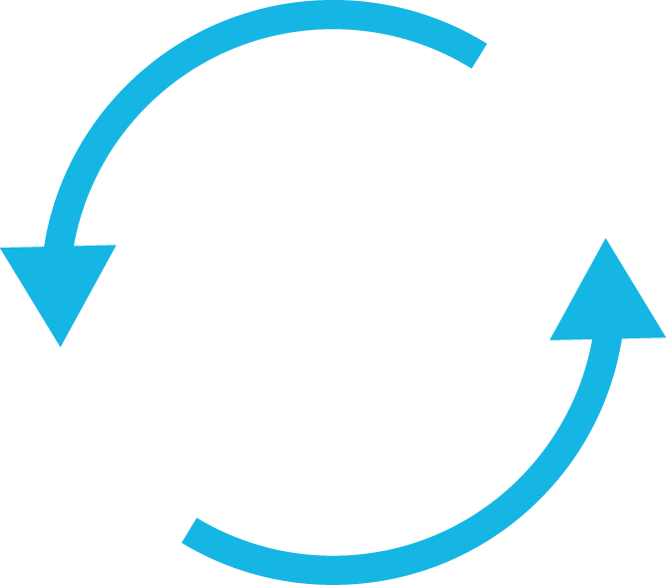
The business impact of good testing practices
Shorter lead time
Lower release times and deliver new apps faster
Always high quality Ensure a quality user experience that keeps users engaged
Broad reach Keep up with the constantly changing device market
Frequent updates Solve issues, push app updates out quickly, and focus on innovation
Notes:
In a market that is as dynamic and fast-moving as mobile, the majority of app developers are following agile delivery methods
Agile methodologies put quality right at the center, you are not really agile if you do not focus heavily on quality and testing
Ensuring quality for mobile is now at the forefront of DevOps best practices and many cutting-edge app developers have established Mobile Centers of Excellence or have placed significant emphasis on their testing discipline and processes
The reason for this focus on quality is clear - software quality has direct and measurable business impact:
Having a consumer-grade, top-notch user experience directly impacts brand perception, usage, conversion and engagement rates
Happy users have a positive impact – for example, referrals can boost app adoption by up to 45%
Unhappy users are lost customers – for example, 60% of users will abandon your app if it doesn’t load within 3 seconds
67% of users who encounter a bug never come back
Finally, within specific industries like healthcare or defense, companies are required to keep a well-defined and auditable trail of what’s been tested and when
COST SAVINGS
Another key benefit is cost savings. There’s a few ways to look at this.
1) There’s the obvious ones like the cost for physical ownership/maintenance of devices, which we previously mentioned runs up to $1,400 per device annually. Running everything in the cloud completely eliminates this.
2) There’s also the time and costs associated with QA specialists executing manual tests that won’t have the same app coverage as automated testing. Quote from MixRadio CTO: ‘Saved 2000 hours of manual testing’
3) From a macro level, there’s the opportunity cost of not getting to market fast enough – this leads to lost market share, user attrition, loss of competitive advantage, decrease in brand equity.
Overall, we’re seeing dev organizations re-evaluate looking at the testing discipline as a cost center – to making it an integral part of the DevOps lifecycle in a modern software organization. OpEx
QUALITY
Goal:
Highest quality, lowest cost, shortest lead time
Maximize output and shrink time between releases
Ensure a quality user experience on any device
Eliminate risk and improve predictability

Slide 33
Monitor and improve
Continuous learning
Get deep insights about availability issues and crashes of apps and services.
Analyze results from beta testing and platforms and devices coverage.
Learn from production usage and connect to direct marketing actions.
Notes:
Once an app has been delivered into the hands of users, the project is by no means finished!
Instead, apps in production need to be monitored 24x7 and the data that is collected needs to inform the decisions for the next iteration of the product
In addition, experimentation can yield valuable data that makes the end product better

Slide 34
Products and features
The Microsoft Mobile DevOps solution

Slide 35
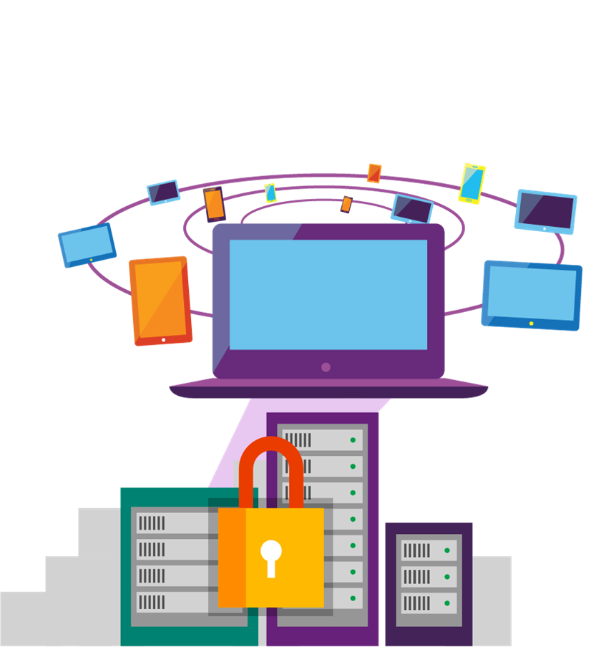


The Microsoft Mobile DevOps Solution
A comprehensive solution for developers and organizations that want to plan, build, test, deploy, operate, and monitor mobile business applications.
Create rich, cross-platform
mobile experiences
Connect mobile applications
to business data and applications
Deliver mobile applications with digital-era agility + velocity
Notes:
The Microsoft Mobile DevOps Solution - everything you need to meet the mobile challenge and delight your customers
Microsoft provides an end-to-end solution for creating state-of-the-art mobile experiences across any device (Android, iOS, and Windows)
The Microsoft Mobile DevOps solution maximizes development productivity and adapts to your needs and skills, and features powerful cloud services that make it easy to securely extend your business to mobile
The Microsoft solution adapts to the needs of your organization and the app being built, supporting a flexible set of mobile development options from multi-device native applications to mobile web and hybrid apps
Together with the Microsoft cloud platform and our integrated DevOps tooling, it provides a comprehensive solution for developers to plan, build, test, deploy, operate, and monitor mobile business-to-business as well as business-to-consumer applications

Slide 36
Create rich, cross-platform
mobile experiences
Create consumer-grade native mobile experiences for iOS, Android and Windows
Share app logic and code across device platforms and build your app only once
Build mobile web and hybrid experiences that take advantage of device features
Notes:
Create rich, cross-platform mobile experiences
Tailored to the needs of your application, building on your skills
Create amazing mobile experiences for Android, iOS or Windows without sacrificing productivity or slowing time to market
Select the strategy that best fits your needs: develop multi-device apps that are native, browser-based, or hybrid, and use your existing skills and knowledge of .NET or HTML and JavaScript development
Deliver high-quality, consumer-grade native mobile experiences
Share app logic and code across device platforms and build your app once instead of multiplying effort and cost
Create compelling mobile and web experiences that take advantage of unique device features
Build mobile apps for Android and iOS devices with all the power and productivity of Visual Studio

Slide 37
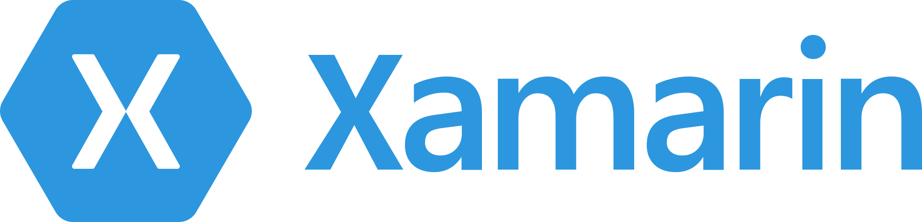

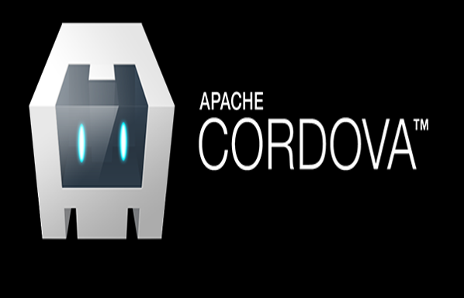
Microsoft supports your choice
.NET
Desktop apps
Universal Windows apps
Web
Native
Browser-based applications
HTML

Slide 38
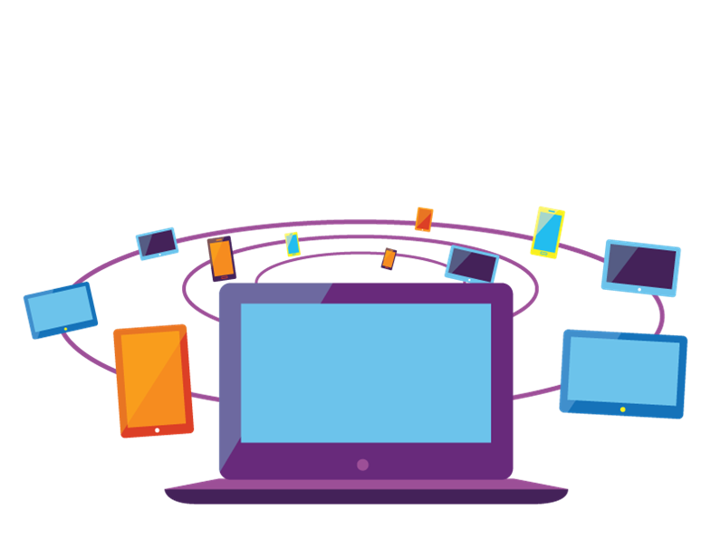
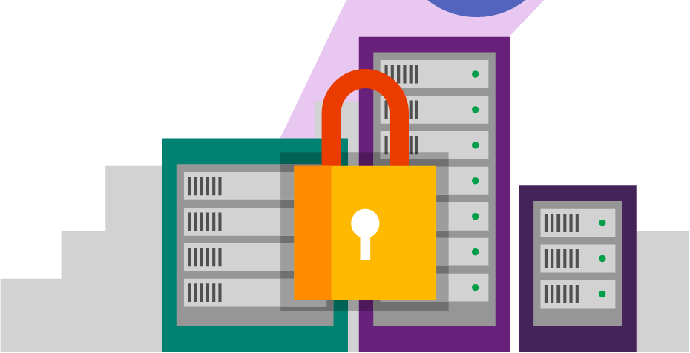
Connect mobile applications
to business data and applications
Scale instantly with a mobile app back end hosted in Microsoft Azure
Use cloud services to connect mobile apps to your IT infrastructure, applications and data
Integrate with dozens of cloud-based services and enterprise applications
Notes:
Connect mobile experiences to business data and applications
Extend your business to mobile with powerful cloud services
Connect your mobile applications to powerful cloud services that scale instantly and are securely connected to enterprise data, LOB applications and identity – and maximize developer productivity and code and skill set reuse across client and cloud
Scale instantly with a back end hosted in Microsoft Azure while always staying connected to your on-premises data
Use cloud services to connect mobile applications to your organization’s IT infrastructure, LOB applications and identity
Automate business processes and integrate with SaaS and enterprise applications with out-of-the-box connectivity to dozens of cloud-based services and applications
Accelerate developer productivity with a unified developer experience across client and backend

Slide 39


The most flexible cloud for the enterprise
Software as a service
Microsoft Dynamics
Enterprise Mobility
Microsoft Enterprise Mobility Suite
Microsoft Azure Enterprise Cloud Platform
Infrastructure as a service
Virtual Machines + Virtual Networking + Cloud Storage
Platform as a service
Azure App Service
Data + Analytics
SQL Azure + Machine Learning + Cognitive Intelligence
Developer services
Visual Studio Family + Xamarin Test Cloud + HockeyApp
Notes:
The Microsoft cloud offers many different options and services, from out-of-box SaaS to IaaS and PaaS
For app developers, the Microsoft App Platform gives you a wide range of services tat you can use to infuse your app with advanced features and capabilities without requiring you to build everything from scratch
The complexity required for applications nowadays grows by leaps and bounds
Applications not only need to be able to be consumed from any device, but are required to offer more and more intelligence and sophistication in the capabilities they provide
Scenarios like Big Data, machine learning, IoT, analytics … and challenges like identity integration, handling of structured and unstructured data … are all examples of capabilities we now expect in almost any application

Slide 40


Azure App Service Build and scale great cloud apps
Web Apps
Mobile Apps
Logic Apps
API Apps
Notes:
App Service is a cloud platform to build powerful web and mobile apps that connect to data anywhere, in the cloud or on-premises
Web Apps allow you to quickly create and deploy mission critical web apps and web service backends that scale with your business
Mobile Apps allow you to quickly build and host the backend for any mobile app and add must-have functionality to your app
Logic Apps help you automate business processes across SaaS and on-premises
API Apps enable you to easily build and consume APIs in the cloud

Slide 41
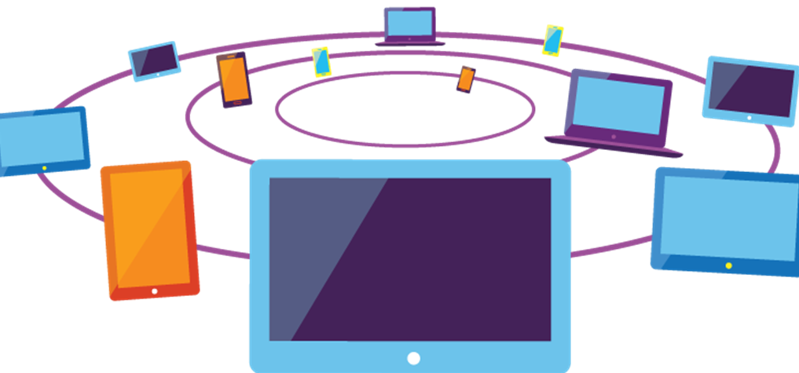
Mobile backend as a service with App Service
Add must-have functionality to your mobile app, quickly
Add corporate sign-on in seconds
Use offline data sync to build responsive apps
Connect your apps to on-premises data
Broadcast push notifications to millions in minutes
Autoscale to fit your business
Notes:
With the Mobile Apps feature of Azure App Service, it’s easy to rapidly build engaging cross-platform and native apps for iOS, Android, Windows, or Mac; store app data in the cloud or on-premises; authenticate users; send push notifications; or add your custom backend logic in C# or Node.js
Add corporate sign-on in seconds
Easily authenticate your users with Active Directory; securely connect to on-premises resources like SAP, Oracle, SQL Server, and SharePoint; and leverage cross-platform frameworks like Xamarin and Apache Cordova to build enterprise-grade apps for your employees
Use offline data sync to build responsive apps
Create robust apps that remain useful when there are network issues, so that users can create and modify data even when they're offline
Improve app responsiveness by caching server data locally on the device
With Mobile Apps you can easily provide a native sync experience across your iOS, Android, and Windows apps
Connect your apps to on-premises data
Azure lets you build mobile apps that can consume data from your own data center
With Hybrid Connections and VPN, it's easy to access your data securely from your on-premises data centers from anywhere in the world
Broadcast personalized push notifications to millions in minutes
Notification Hubs is a massively scalable mobile-push notification engine capable of sending millions of push notifications to iOS, Android, Windows, or Nokia X devices within seconds
You can easily hook Notification Hubs into any existing app backend, whether that backend is hosted on-premises or in Azure
Autoscale to fit your business
Easily configure built-in autoscale for both Mobile Apps and Notification Hubs to match your app needs
Spin up/down resources based on actual usage and pay only for what you need
With access to the global network of Microsoft managed data centers, you can reach users anywhere in the world

Slide 42

Deliver mobile applications with digital-era agility and velocity
Plan, build and deliver mobile apps with an integrated, mobile-specific DevOps toolset
Test on real devices and capture beta test feedback for real quality
Close the loop between development and production for continuous improvement
Notes:
Deliver mobile experiences with digital-era agility and velocity
Shorten your development cycles and deliver better apps, more frequently
The Microsoft cloud platform, development tools, and DevOps services are an end-to-end solution for teams of any size to plan, build, test, deploy, operate, and monitor mobile applications across client and backend
Achieve faster development cycles with state-of-the art DevOps tools and an agile, end-to-end, tools-to-platforms solution
Streamline application delivery and boost the productivity and quality of any mobile project with a full range of integrated, mobile-specific QA tools, including test management, exploratory testing, performance testing, automated UI testing on thousands of real devices, and beta testing
Close the loop between development and production, fix bugs faster and evolve your application over time with insights and learnings captured directly in production.

Slide 43

Plan & Track Work
Source Code Management
Package Management
Quality Management
Cross-platform Build
Continuous Deployment
Release Management
Feedback Management
Application Telemetry
Extend and Customize
Visual Studio Team Services
Team Foundation Server

Slide 44
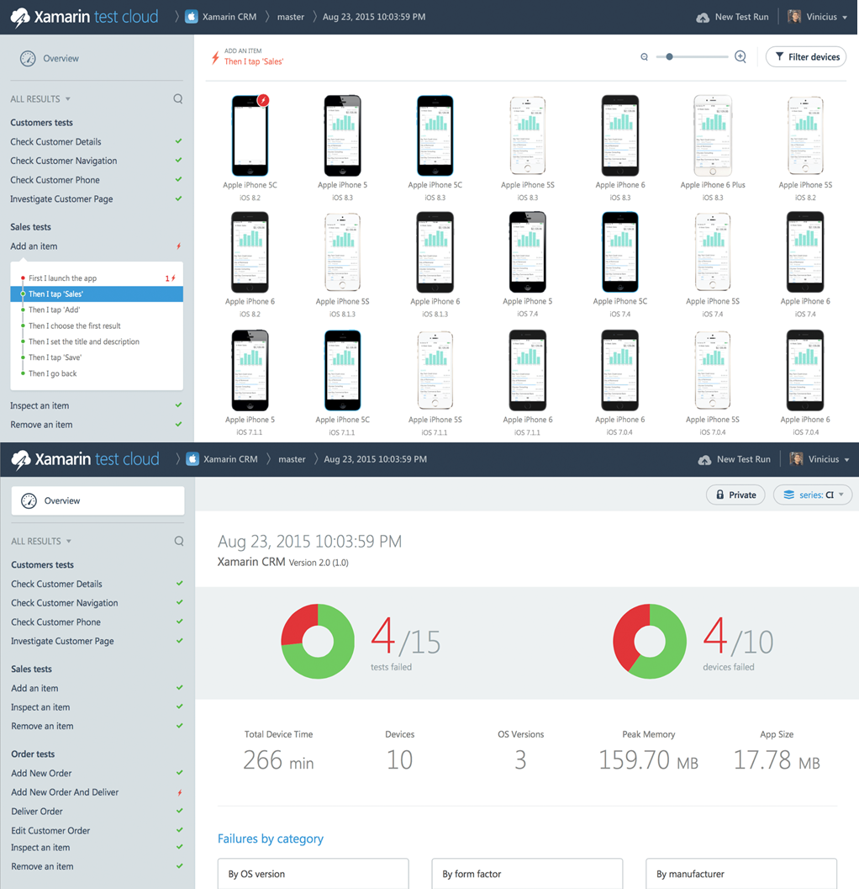
TESTS for
Mobile app quality, done right
Diverse library of real devices
Simulate user interactions
Test continuously
Analyze app performance
Use the tools you know
Test native device functionality

Slide 45
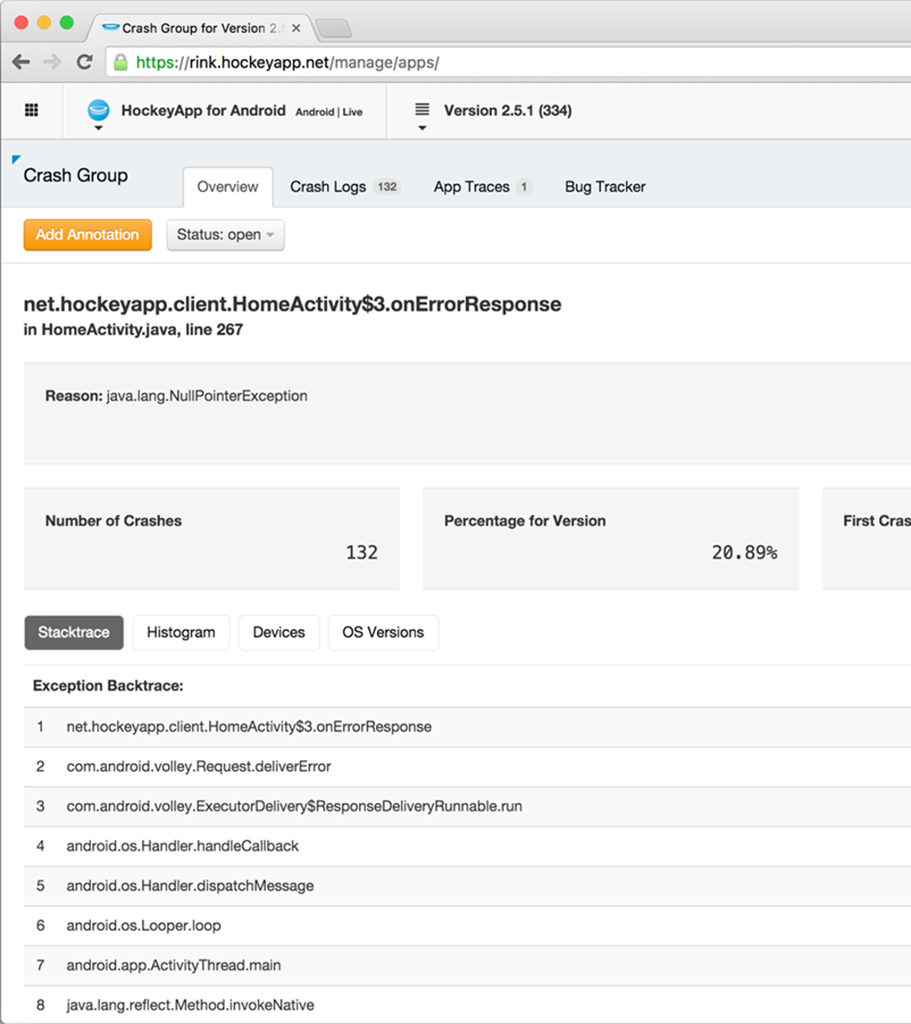

for
Bringing DevOps to mobile apps
Distribute your app
Collect crash reports
Gather user feedback
Understand app adoption
Track app usage

